Slide 1

ElectViz
Election Data Visualization for Media
Multi-phase Indian election analysis with interactive Power BI dashboards delivering comprehensive insights for media storytelling.

Slide 2


Data Collection & Cleaning
Sources
Power Query Steps
Kaggle datasets with state, constituency, party, candidate, votes, electors, phase mapping, and postal/EVM splits.
Removed nulls, trimmed text, enforced data types, deduplicated on composite keys, filtered out totals.
Normalization
Standardized state/UT names, harmonized party abbreviations, split EVM vs Postal votes into separate columns.

Slide 3


Data Modeling
Star Schema
Relationships
FactVotes at grain State–Constituency–Party–Phase with dimensional tables for Date, State, Party, Candidate, Phase.
One-to-many from dimensions to FactVotes with active relationships on StateKey and PhaseKey. Date table marked for time intelligence.
One big table in the center with numbers (the fact), surrounded by small descriptive tables (the dimensions).
Calculated Keys
Stable Joins
Integer surrogate keys in each dimension (e.g., StateKey = 101 for "Uttar Pradesh") avoid spelling mismatches and speed joins.
Keys created during Power Query/ETL and carried into fact table for consistent relationships.

Slide 4

DAX Measures & Calculations
Calculated Columns
Core Measures
Margin
Total Difference = SUM('Counted vs polled'[Difference])
Total states in different phase
VoteType (EVM/Postal)
Total EVM Votes Counted
CleanParty for grouping and top-N
Total PC'S = DISTINCTCOUNT
Total Candidates, Constituencies
Top N Parties by Votes using RANKX
Visual logic: phase-aware measures using TREATAS/ISFILTERED to reflect slicer selection and persist KPI cards.

Slide 5
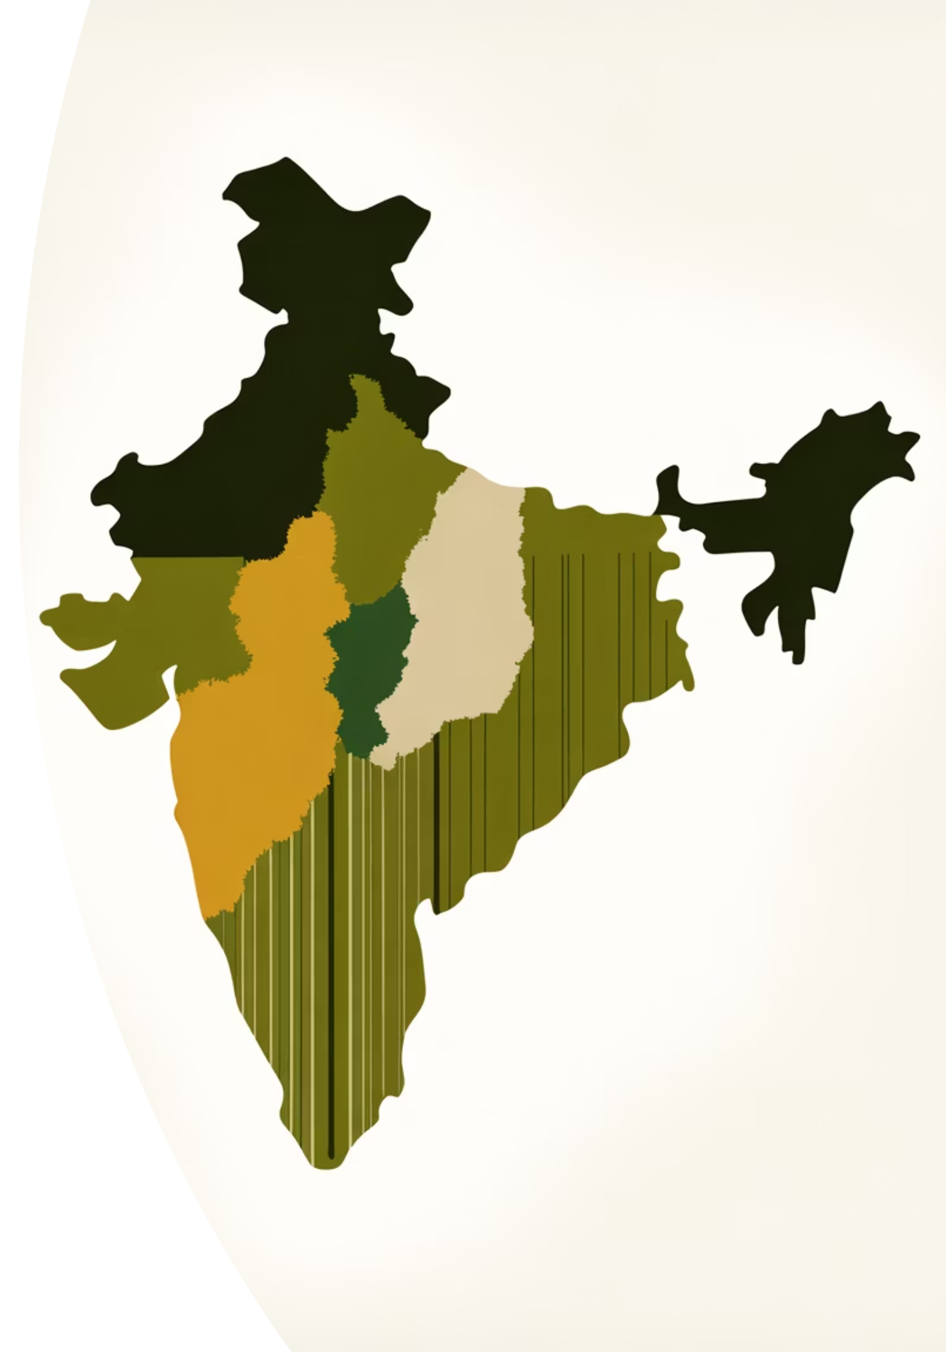
Main Dashboard
National Overview
01
02
KPIs
Purpose
Total states, constituencies, candidates, aggregate votes across all phases. Donut for party vote share, bar for top parties, treemap for votes by state.
Quick national snapshot with drill-through to state/phase. Highlights BJP and INC at top, with Independents and regional parties visible.
03
Usage
Slicers for State, Party, Constituency enable targeted exploration and media-style storytelling.

Slide 6
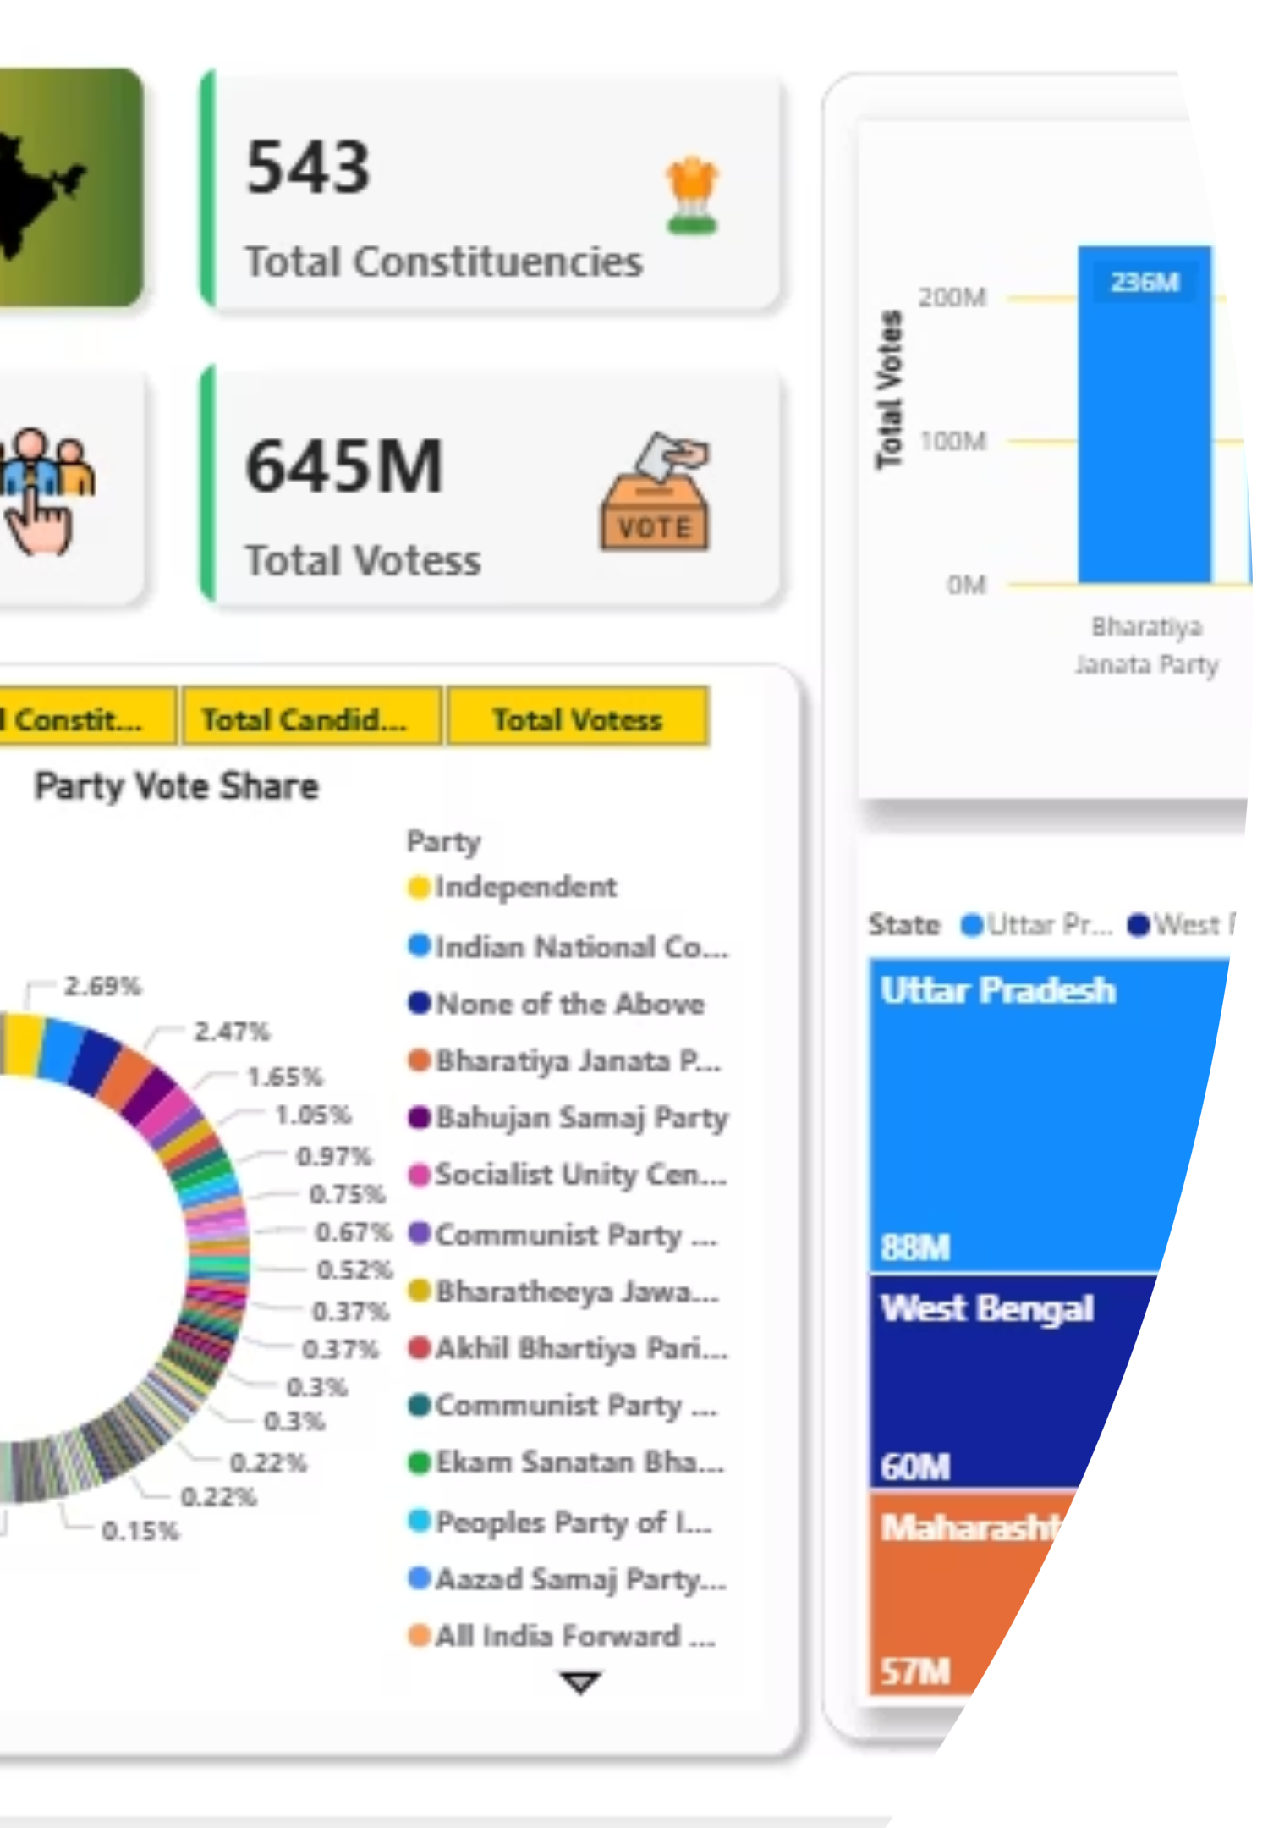
Dashboard in Action
Interactive national overview showing party distribution, state-wise votes, and key performance indicators for comprehensive election analysis.

Slide 7

Counting & Margins Dashboard
EVM Votes
Postal Votes
Polled vs Counted
Distribution
Total EVM Votes Polled vs Counted with Total Difference tracking.
Total Postal Votes analysis across states and constituencies.
Margin Analysis
Victory Margins
Sum of Margin and margin by state heat/category bars.
Surfaces states with larger deltas between polled and counted votes, and where victory margins cluster—aiding operational and results-night narratives.

Slide 8
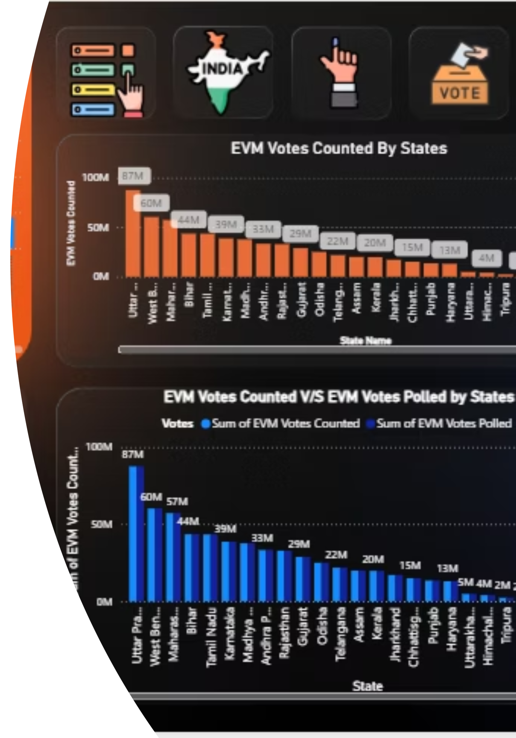
Counting Dashboard View
Detailed view of EVM and postal vote distribution with margin analysis, enabling precise tracking of counting progress and result patterns.

Slide 9
Phase-by-Phase Snapshots
Each phase card displays: Total Electors, Total Votes, States in phase, bar of Total Votes by State, funnel of Total Electors by State, and pie of Poll % by State.
Phase 1
1
Tamil Nadu dominates votes and electors; broad long-tail across many smaller states/UTs.
2
Phase 2
Karnataka and Kerala lead; strong showings from Rajasthan and Uttar Pradesh.
Phase 3
3
Gujarat and Karnataka head the phase; Maharashtra and Madhya Pradesh follow.
4
Phase 4
Andhra Pradesh and Telangana top electors and votes; UP, Maharashtra contribute significantly.
Phase 5
5
Uttar Pradesh and Maharashtra lead; West Bengal, Bihar, Odisha notable.
6
Phase 6
Uttar Pradesh and Haryana are phase anchors; NCT of Delhi and Bihar are key contributors.
Phase 7
7
Uttar Pradesh and Punjab dominate; West Bengal and Bihar add sizable shares.

Slide 10
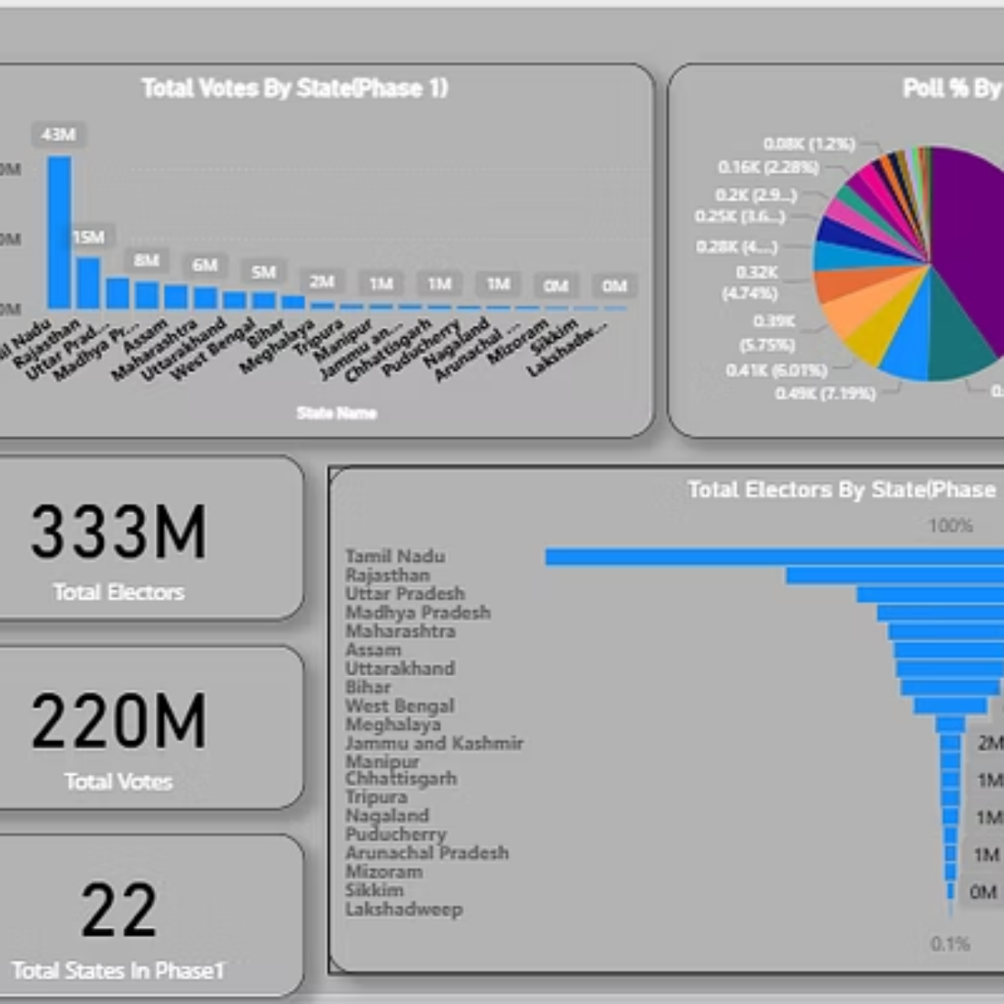
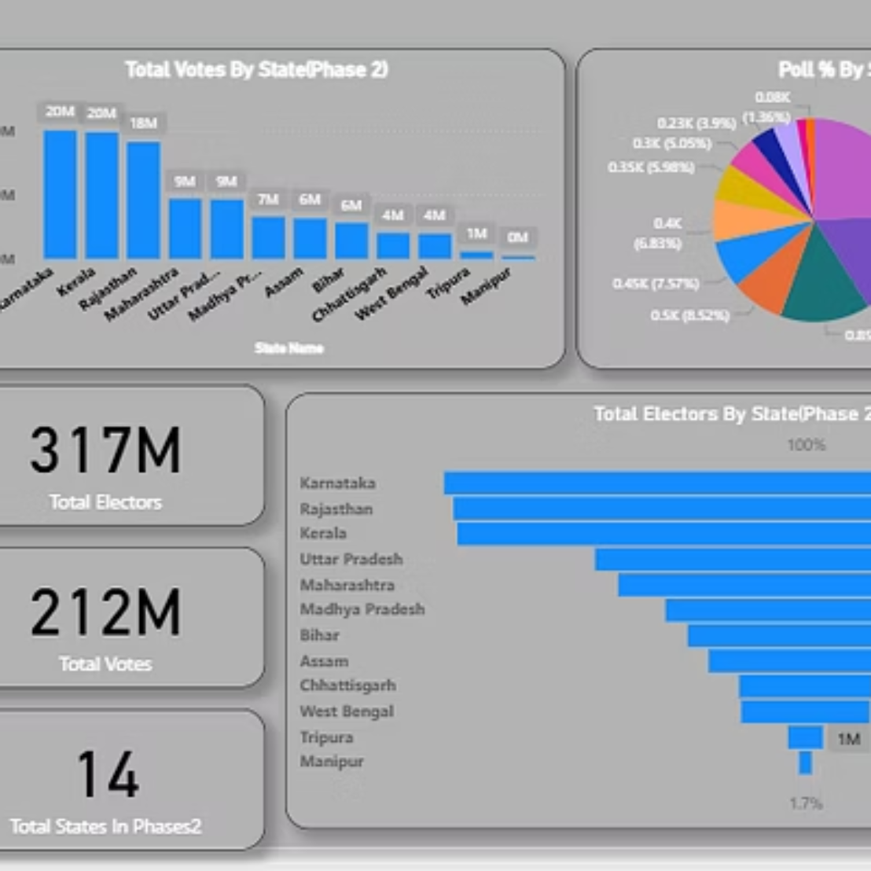
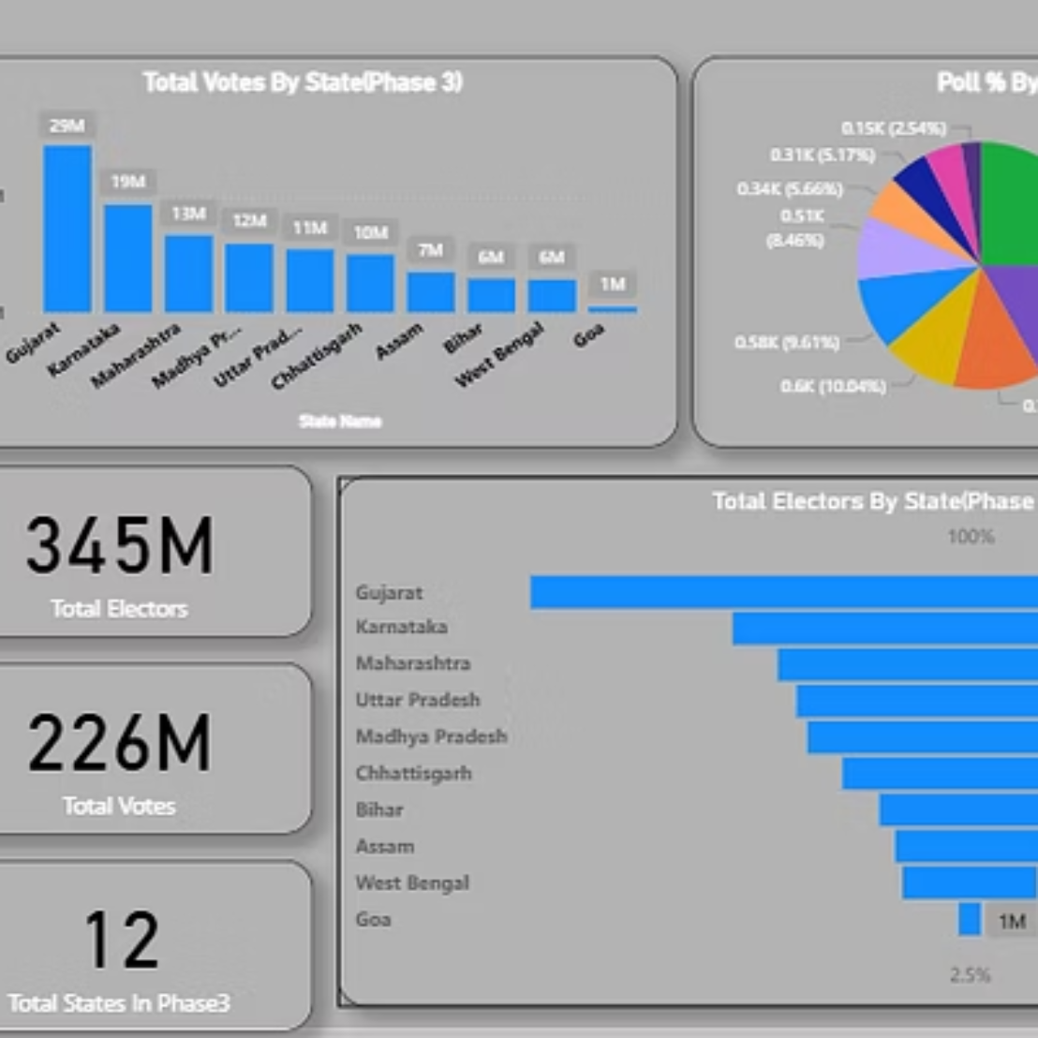
Phase Dashboard Views
Comprehensive phase-wise visualizations showing elector distribution, vote totals, and polling percentages across all seven phases of the Indian election.

